Slide 1

Portable Routing using quagga and Raspbian
By: Rachit Bhanage(B00784033)

Slide 2

A small, Portable Router & much more…..
Supports Protocols like [RIP] [BGP] [OSPF] [SSH/Telnet] [Zebra]
Runs Raspberry pi as hardware chip(microprocessor) & Raspbian as OS
Quagga as its open source routing protocol
By: Rachit Bhanage(B00784033)

Slide 3

Hey, But Why Make a Project on it ?
By: Rachit Bhanage(B00784033)

Slide 4

Real Network Devices are very costly $
Virtualization Does not Provide real life hardware configuration challenges
Limited Testing Functionalities.
Small companies = Small(Budget + Team)
By: Rachit Bhanage(B00784033)

Slide 5

# Tiny
# Development Scope
# Portable
# Inexpensive
*Open Source
By: Rachit Bhanage(B00784033)

Slide 6

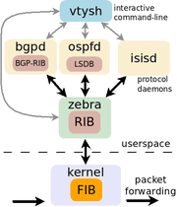
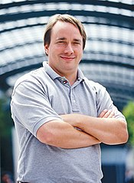
Technologies used:

Slide 7
Thanks !

